Slide 1

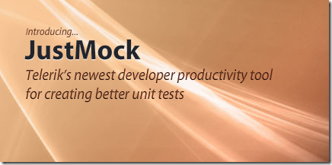
Mocking and JustMock
Mocking Tool for easier unit testing
Telerik Software Academy
Learning & Development
http://academy.telerik.com

Slide 2
How to write testable code
Inverse of Control Pattern
There is a decoupling of the execution of a certain task from implementation
Every module can focus on what it is designed for
Modules make no assumptions about what other systems do but rely on their contracts
Replacing modules has no side effect on other modules
More info at http://en.wikipedia.org/wiki/Inversion_of_control

Slide 3
Inverse of Control
Public API should work with interfaces, not implementation classes (IEnumerable vs. List)
BAD Code:
GOOD Code:
public Card[] Cards { get; private set; }
public IList<ICard> Cards { get; private set; }

Slide 4
How to write testable code
Dependency Injection
MS Unity - http://unity.codeplex.com/
Consists of:
a dependent consumer,
a declaration of a component's dependencies, defined as interface contracts,
an injector (sometimes referred to as a provider or container) that creates instances of classes that implement a given dependency interface on request.

Slide 5
How to write testable code
BAD:
public interface IViewBase {}
public interface IPresenterBase {}
public class MemoryLayoutView: IViewBase {}
public class MemoryLayoutPresenter: IPresenterBase
{
private MemoryLayoutView view = new MemoryLayoutView();
public MemoryLayoutPresenter() { }
}

Slide 6
How to write testable code
Good:
public interface IViewBase {}
public interface IPresenterBase {}
public class MemoryLayoutView: IViewBase {}
public class MemoryLayoutPresenter : IPresenterBase
{
private IViewBase view;
public MemoryLayoutPresenter(IViewBase myView)
{
this.view = myView;
}
}
public class Program {
static void Main() {
InjectionContainer.Create<typeof(MemoryLayoutPresenter)>();
}
}

Slide 7
Why we use mocking
Makes Unit Testing more effective
Avoid writing boring boilerplate code

Slide 8
Why we use mocking
Isolate dependencies among units

Slide 9
Why we use mocking
Asserts expectations for code quality
Ex: Checks that a method is called only once

Slide 10
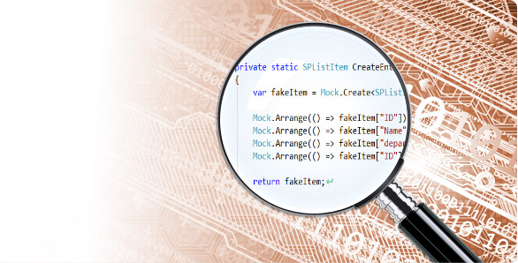
Telerik JustMock
Install from the Telerik account
Use the Visual Studio add-in

Slide 11
Telerik JustMock
Free version – excellent when the code is written with testability in mind
Paid version –mocks everything (ex: mscorlib, EF, SQL), mocks legacy code base which is not written to be testable

Slide 12
JustMock Demo
Sample: writing unit test by hand (without a mocking framework)

Slide 13
JustMock Demo
The most often used APIs:
.Occurence()
.Returns()
.DoInstead()
.Throw()
Arg.AnyInt
Arg.Matches<type>(x => condition)

Slide 14
Mocking and JustMock
http://academy.telerik.com

Slide 15
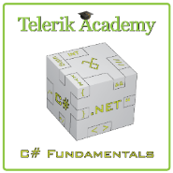



Free Trainings @ Telerik Academy
C# Programming @ Telerik Academy
csharpfundamentals.telerik.com
Telerik Software Academy
academy.telerik.com
Telerik Academy @ Facebook
facebook.com/TelerikAcademy
Telerik Software Academy Forums
forums.academy.telerik.com

